Slide 1
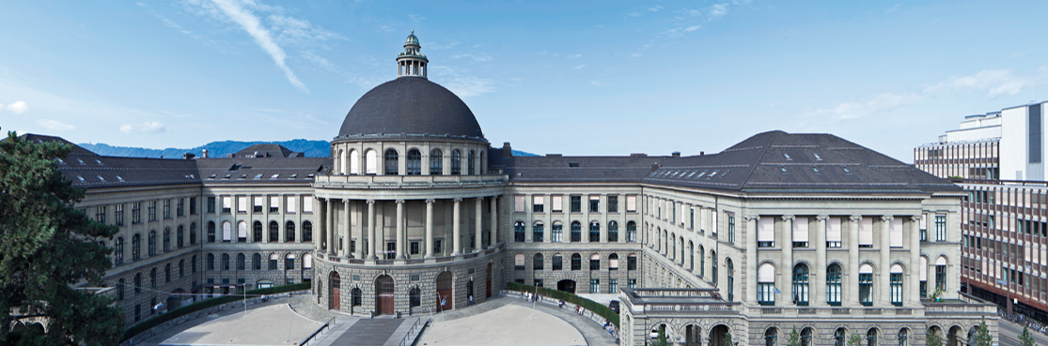
Equal Headway Instability
Project final presentation
Modelling Social System Science with MATLAB
Maicol Fabbri – Cheuk Wing Edmond Lam

Slide 2
Agenda
Introduction
Model description
Simulation results
Conclusion

Slide 3
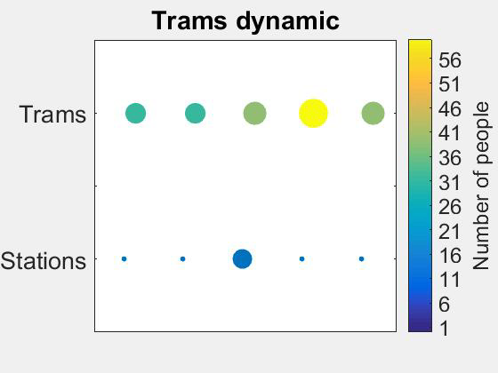
What does equal headway mean?
Trams maintain the same distance between them → schedule is respected!

Slide 4
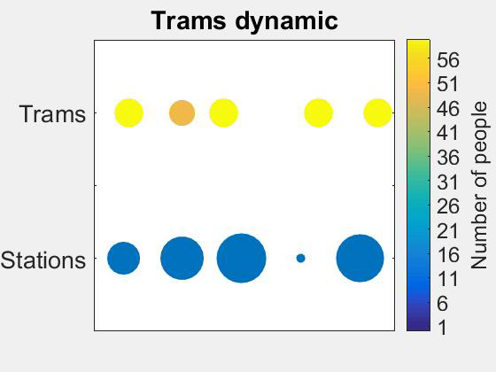
Why trams may arrive late?
High number of people who wants to get off the tram or board
Platooning effect: Trams don’t cover uniformly the track anymore

Slide 5
Research question
Can people improve the public transportation efficiency?
Ground idea: a full and delayed tram is often closely followed by an almost empty and on time tram (platooning effect)
→ Instruct people to skip that tram and take the following one
Empty and ontime tram
Full and delayed tram
Station

Slide 6
The model
Create of a cyclic track
(Matrix)
T
T
T
T
T
2. Add stations
S
S
S
S
S
3. Add trams
The “people rate” is used to trigger the instability.
Remark: with people rate we refere to the mean of the Poisson distribution → people rate=10 means 10 people on average will arrive at a station
Number of people who wants to get off the tram is random
Before moving, boarding operation must be completed
Trams has to wait a minimum time at each station (we have a schedule)
When the schedule is not respected → delay
4. Add discretization of time
(updates in time increments)
A random number of people arrives at a random station after a random number of time instant.
Usage of POISSON distribution with a desired mean value for the “people rate” and the “time instant period”
In each instant of time:
Trams can move of a cell
A well define amount of people can board or get off the tram
5. Make people randomly arrive at the stations
6. Implement tram dynamics
7. Vary the number of people arriving for each time increment

Slide 7
People Behaviour
We instruct people to wilfully skip a tram if:
The incoming tram is delayed
The previous tram was not skipped
The following tram will arrive in half of a tram period
Example: in stable condition, if a tram arrives at a station after 10 time instants → half of time period is 5
Station
5 time instants
Station
10 times instants length

Slide 8
Simulations and result parameters
In the last instant of time, the values collected are:
Average delay of all trams
Average number of people waiting in all the stations
Parameters chosen for the simulation:
Track length=50 cells
Trams=5
Stations=5, equally spaced
Tram capacity=60 people
Boarding rate=20 people/instant
Station waiting time= 3 instants
Note: 50 simulations are performed with the same boundary conditions and the results averaged
→ elimination of aleatoric effects

Slide 9
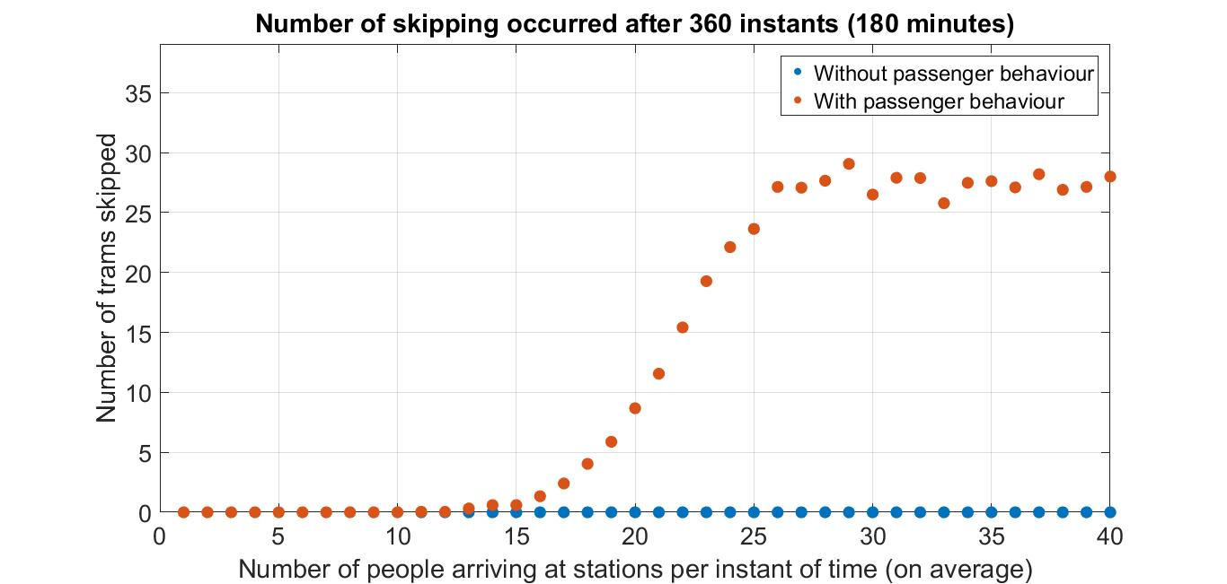
Results – influence of people behaviour
3 Zones
Inactive zone
Active zone
Saturation zone

Slide 10
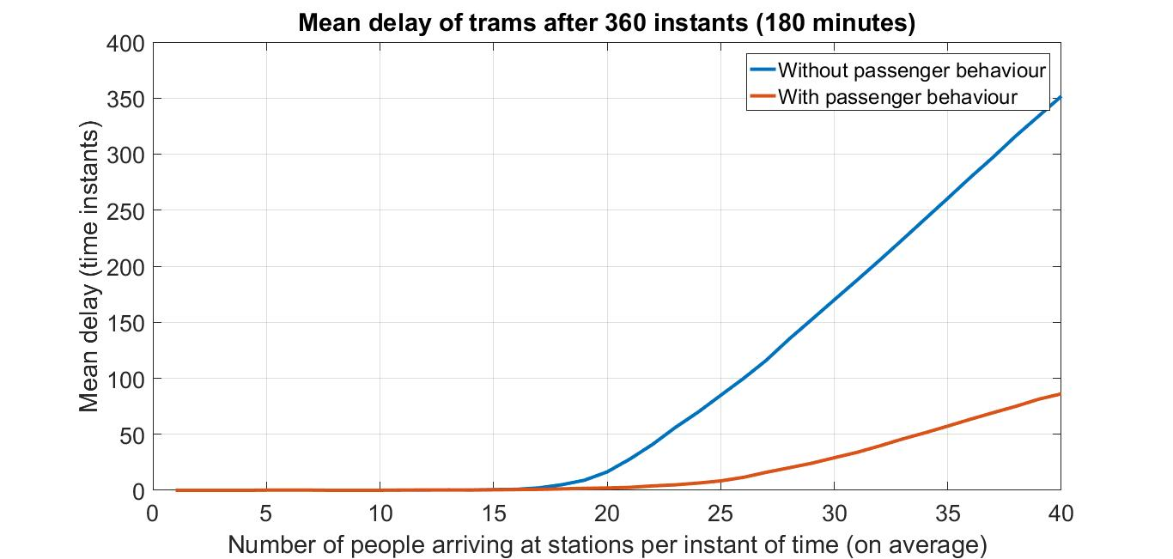
Results – Tram delay
People behaviour drastically reduces tram delay

Slide 11
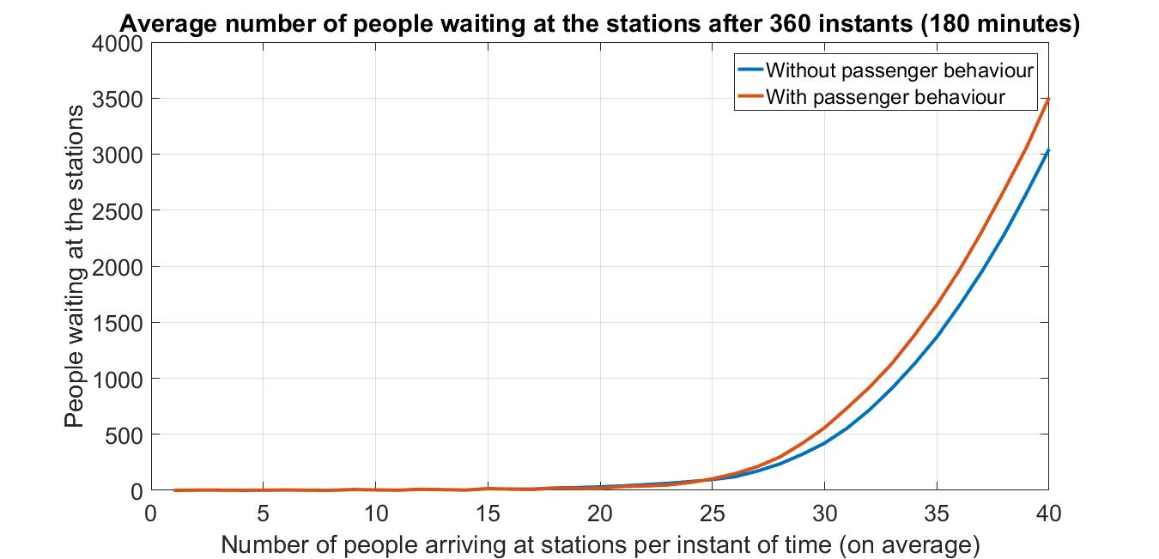

Results – People waiting at the stations
In the “saturation zone”, the people waiting at the stations are more → the skip of a tram leads to less people carried around
Zoom in the “active zone”

Slide 12
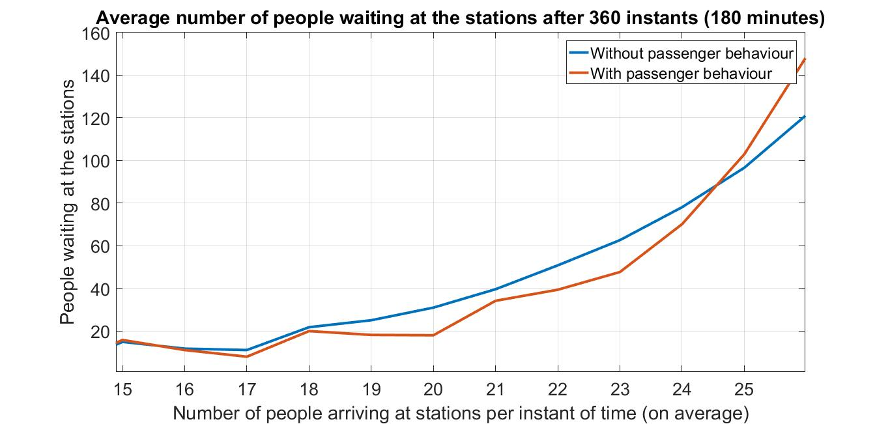
Results – People waiting at the stations – Active zone
People behaviour makes the trams better cover the track → in the active zone, transportation performance are improved
Turning points

Slide 13
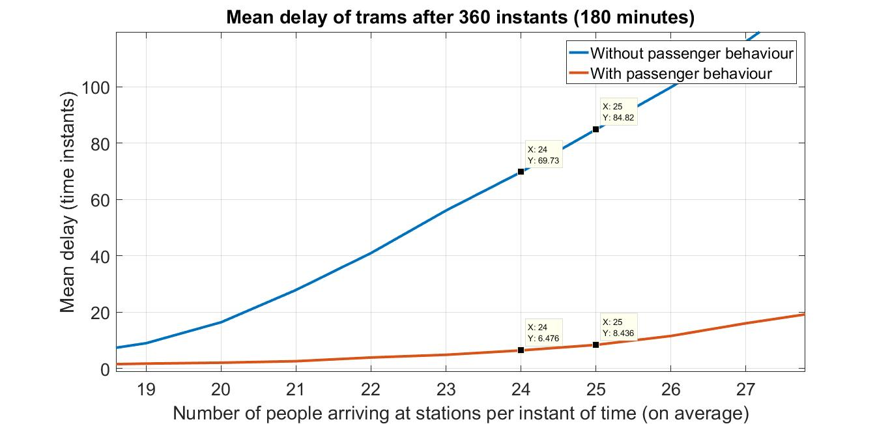
Results – Trams delay – Active zone
X: 25
Y: ~85
X: 24
Y: ~70
Reduction of ~90%
Reduction of ~90%
X: 24
Y: ~6.5
X: 24
Y: ~8.5

Slide 14
Conclusion
People behaviour can have a huge positive influence in the public transportation efficiency
Choosing to wait few minutes more can brings benefits to all the other passengers
Dilemma: maximizing own profit or cooperate for a collective gain?
Remark: the numerical values shown strongly depends on the boundary conditions imposed. Nevertheless, several tries with different boundary conditions and parameters have shown the same positive results

Slide 15

Thank you for your attention

